Slide 1
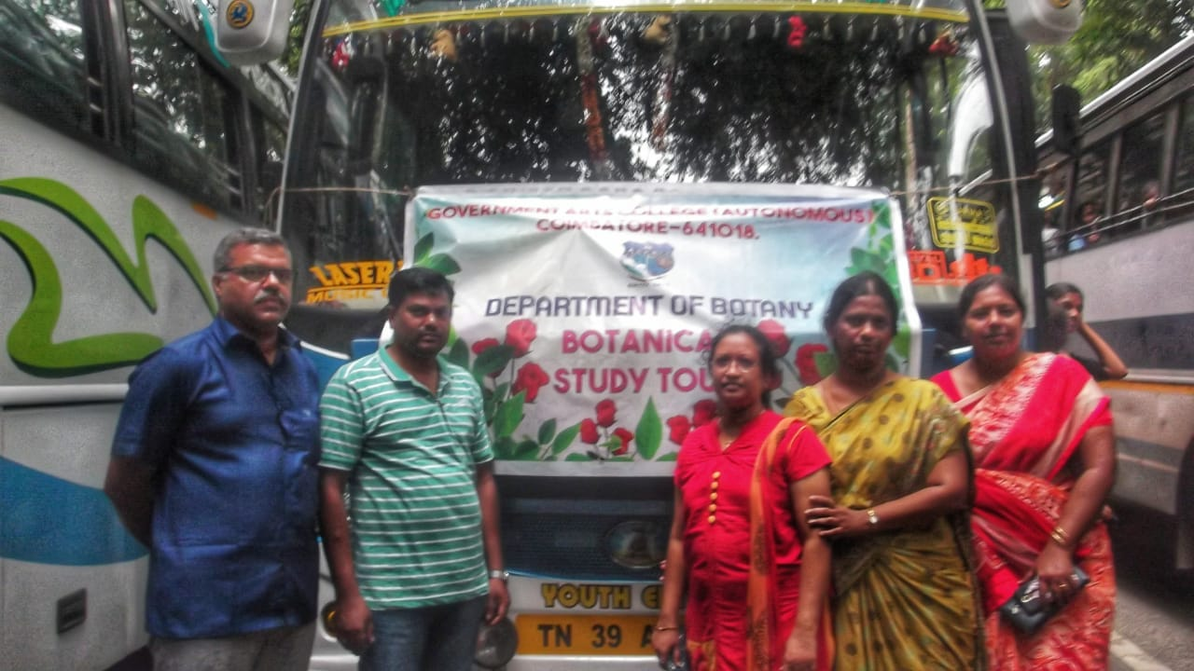

Slide 2
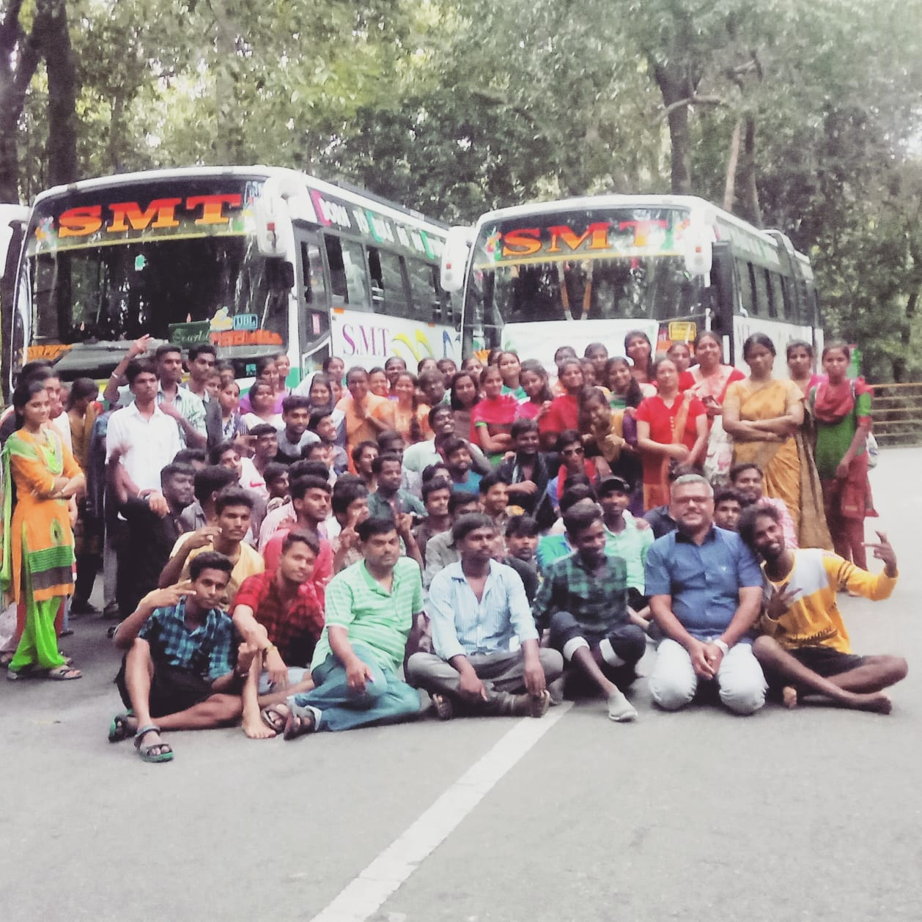
PLANT COLLECTION TRIP:PONMUDI HILLS, THIRUVANANTHAPURAM,KERALA

Slide 3
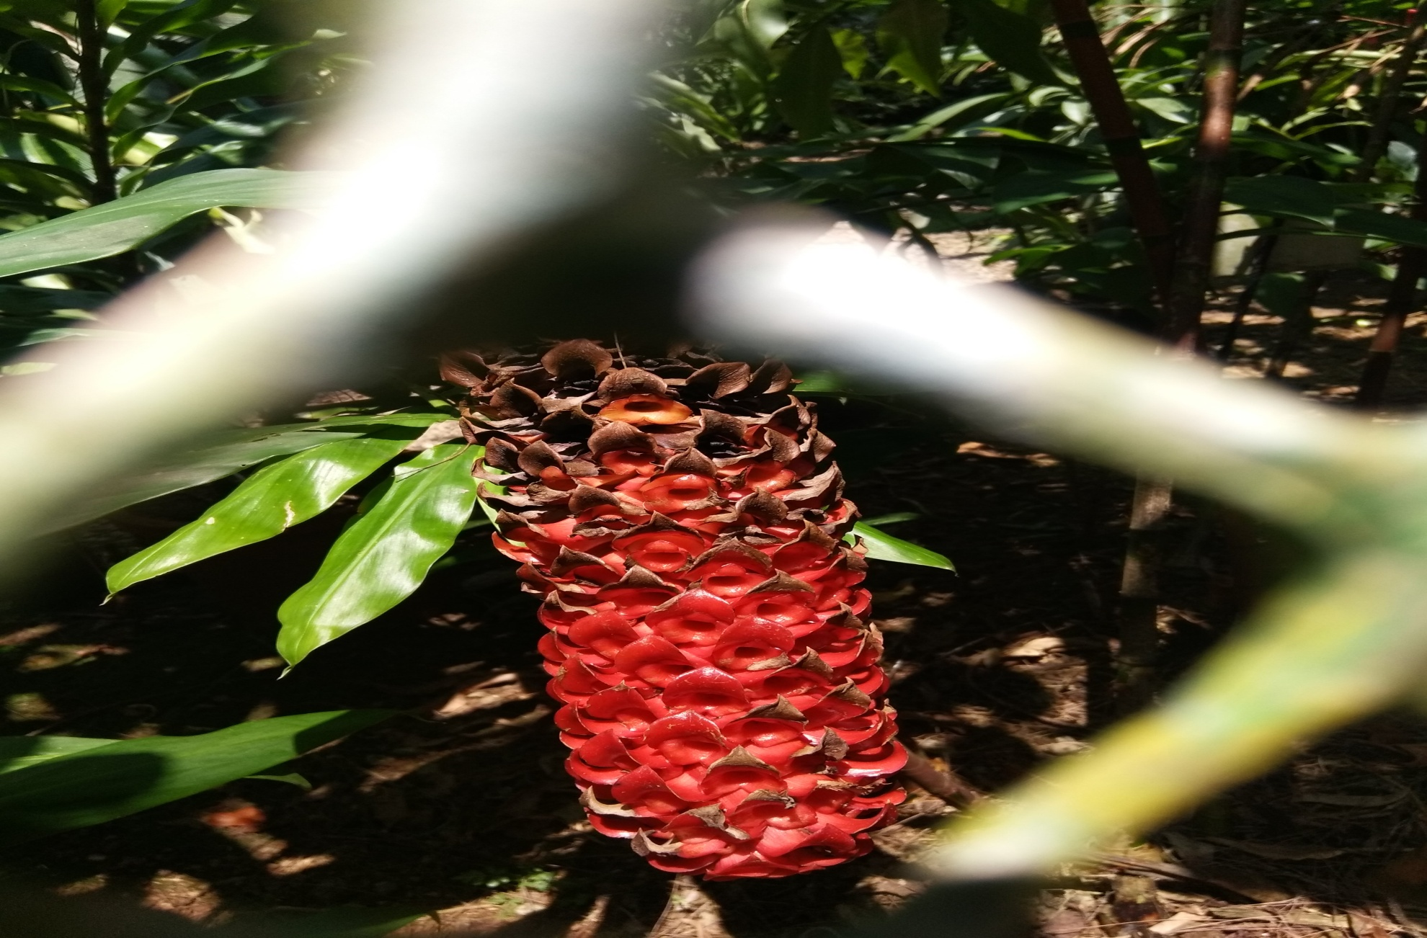
GINGER GARDEN@ JNTBGRI

Slide 4
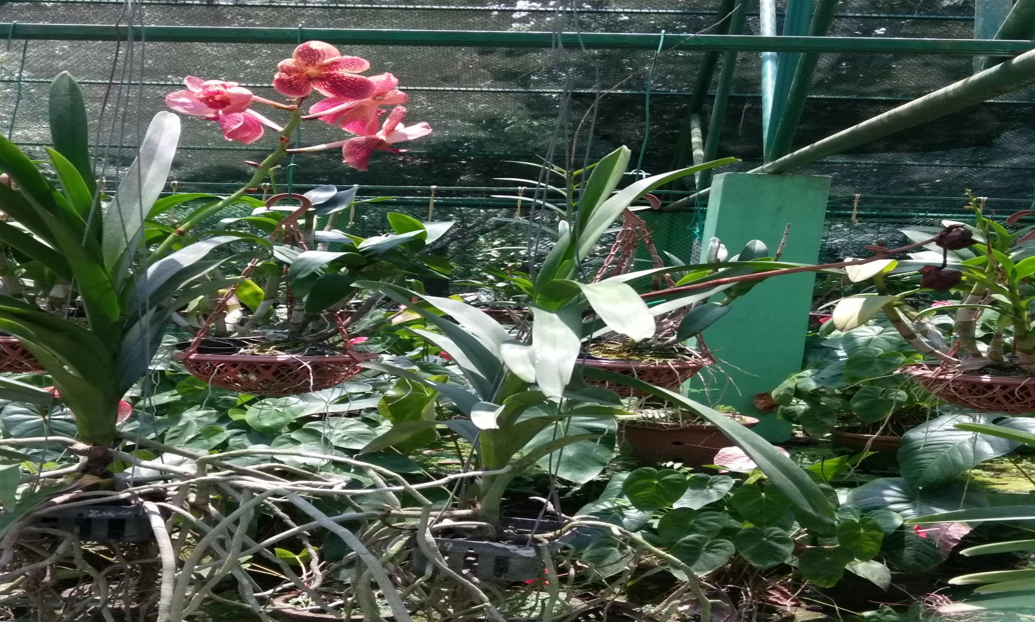
ORCHID @ JNTBGRI

Slide 5
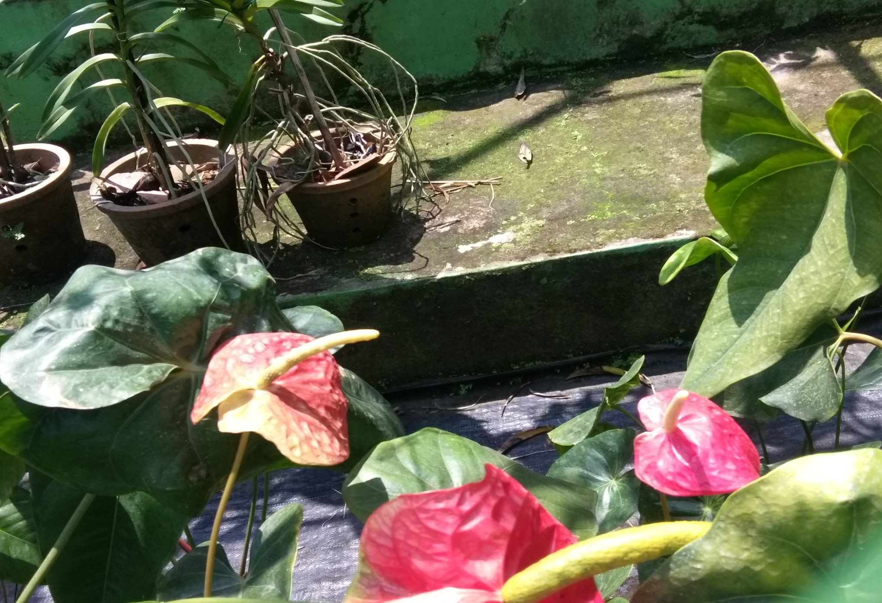
ANTHURIUM @ JNTBGRI

Slide 6
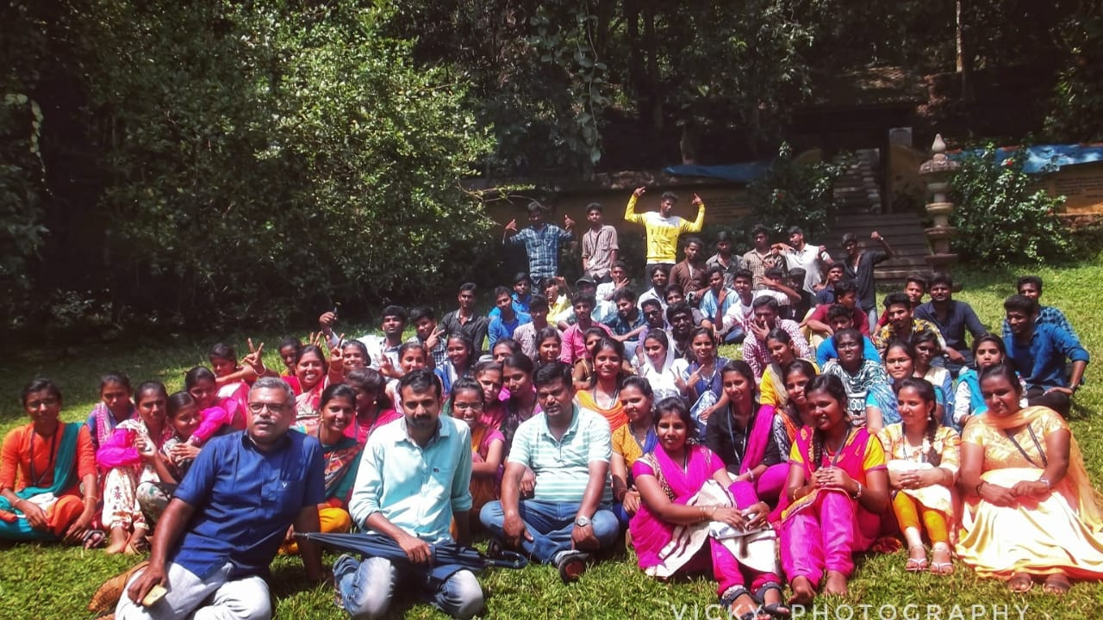
Students and Teachers with guide at Jawaharlal Nehru
Tropical Botanic Garden and Research Institute

Slide 7
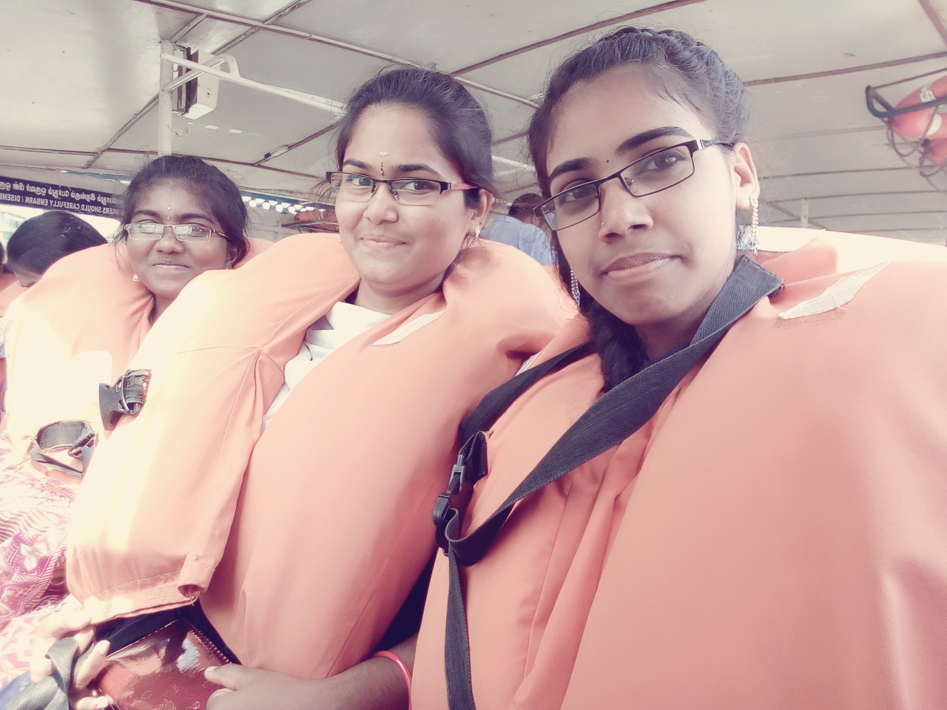
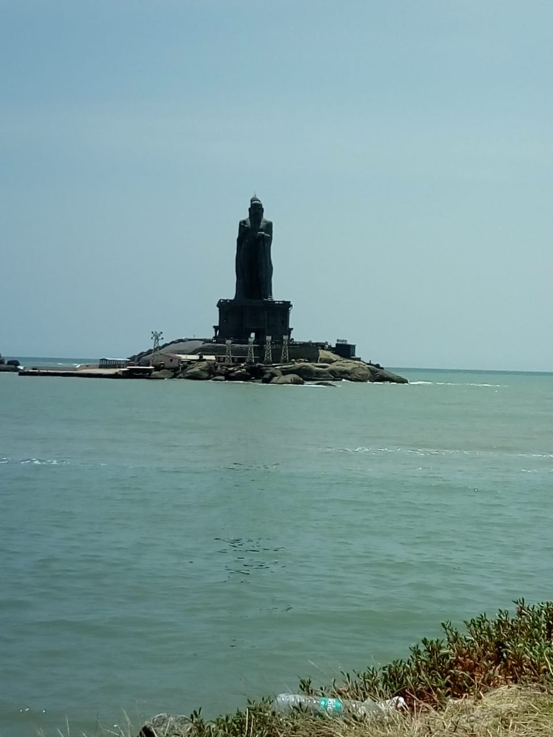
Boating towards Vivekanandhar rock.

Slide 8
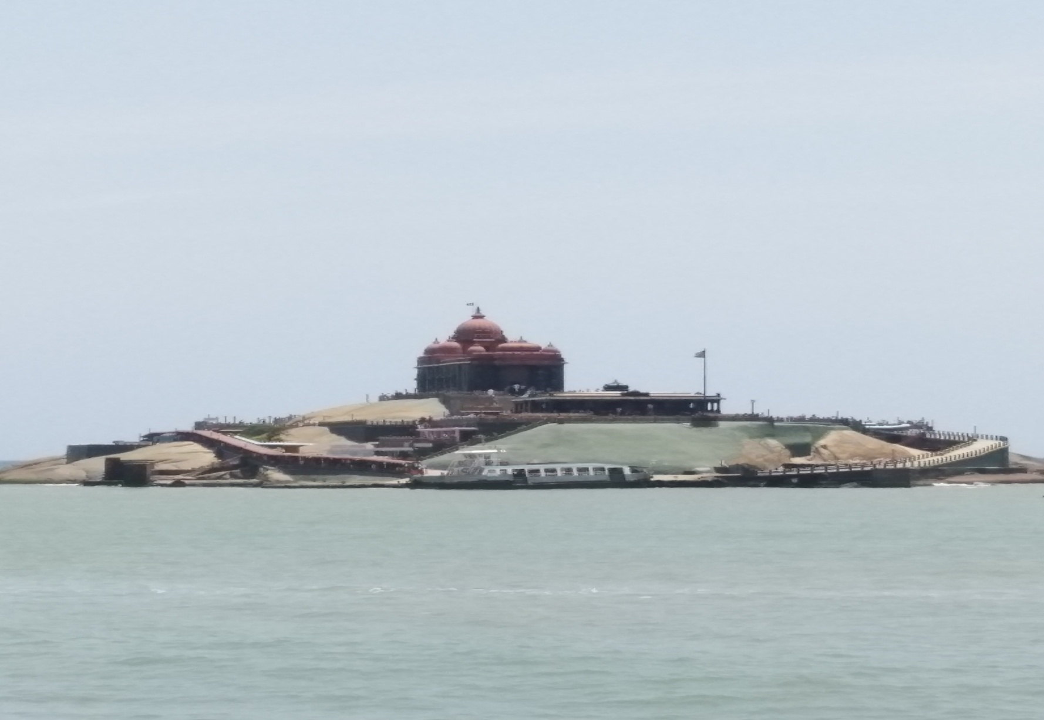
Vivekanandhar rock.

Slide 9
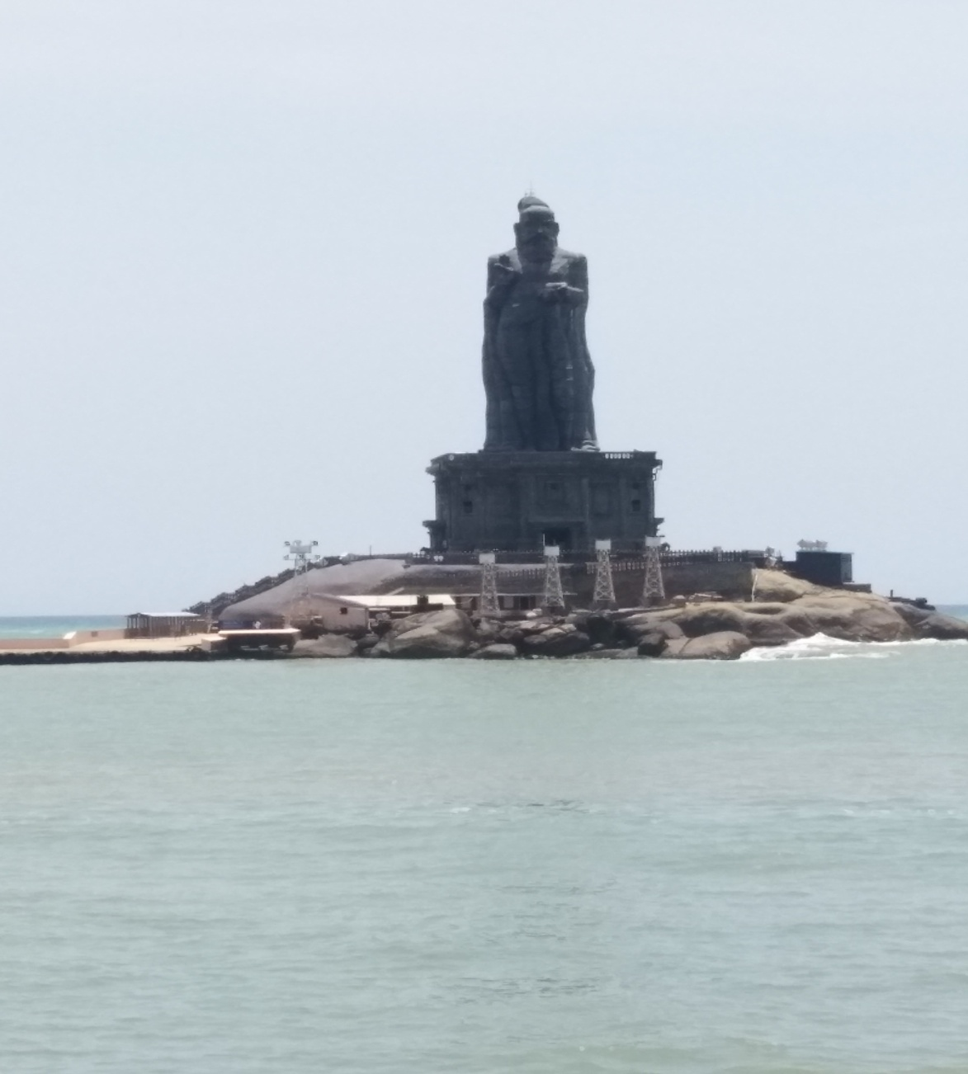

Thiruvalluvar statue and Viveganandhar rock.

Slide 10
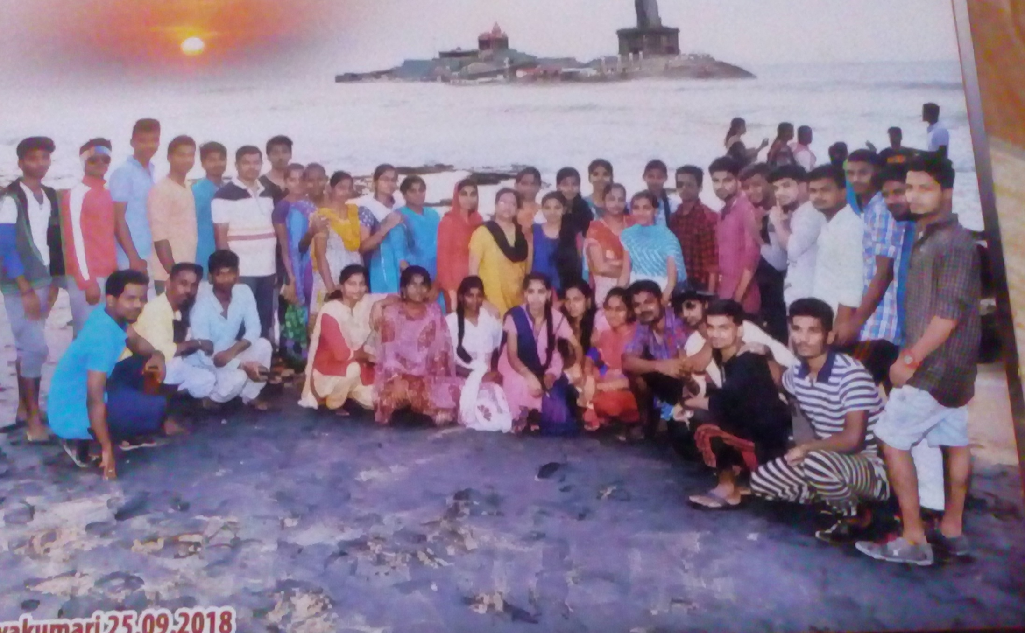
In Kanyakumari, Algal collection at the time of sun rise

Slide 11
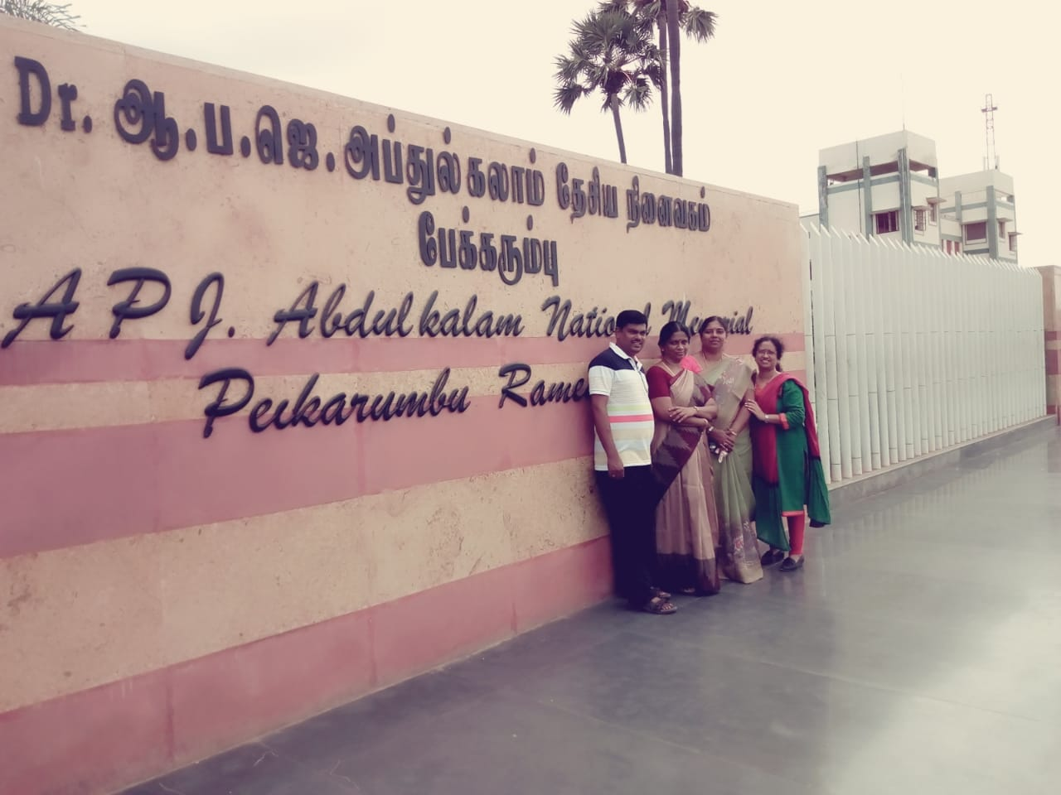
Abdul kalam national memorial,Rameshwaram.

Slide 12
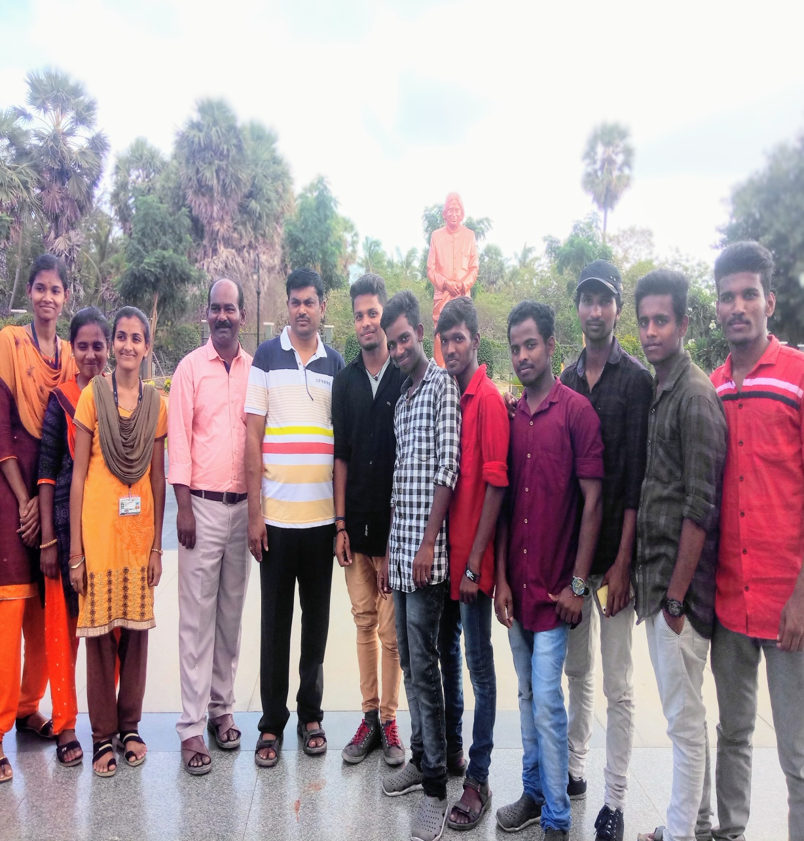
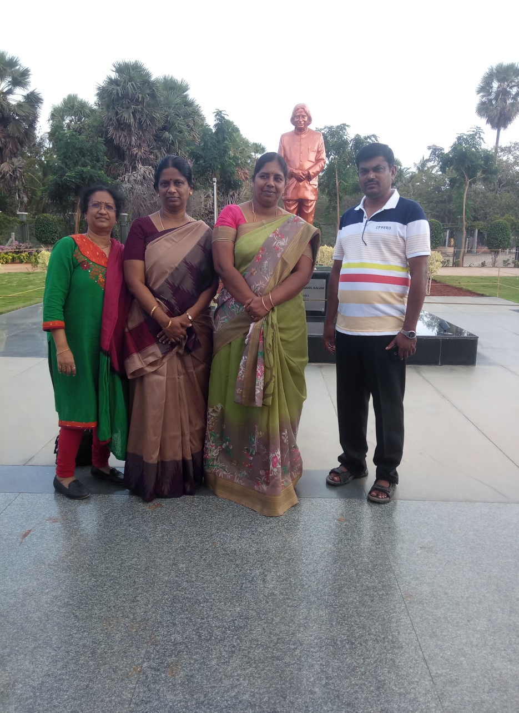
Abdul kalam memorial hall

Slide 13
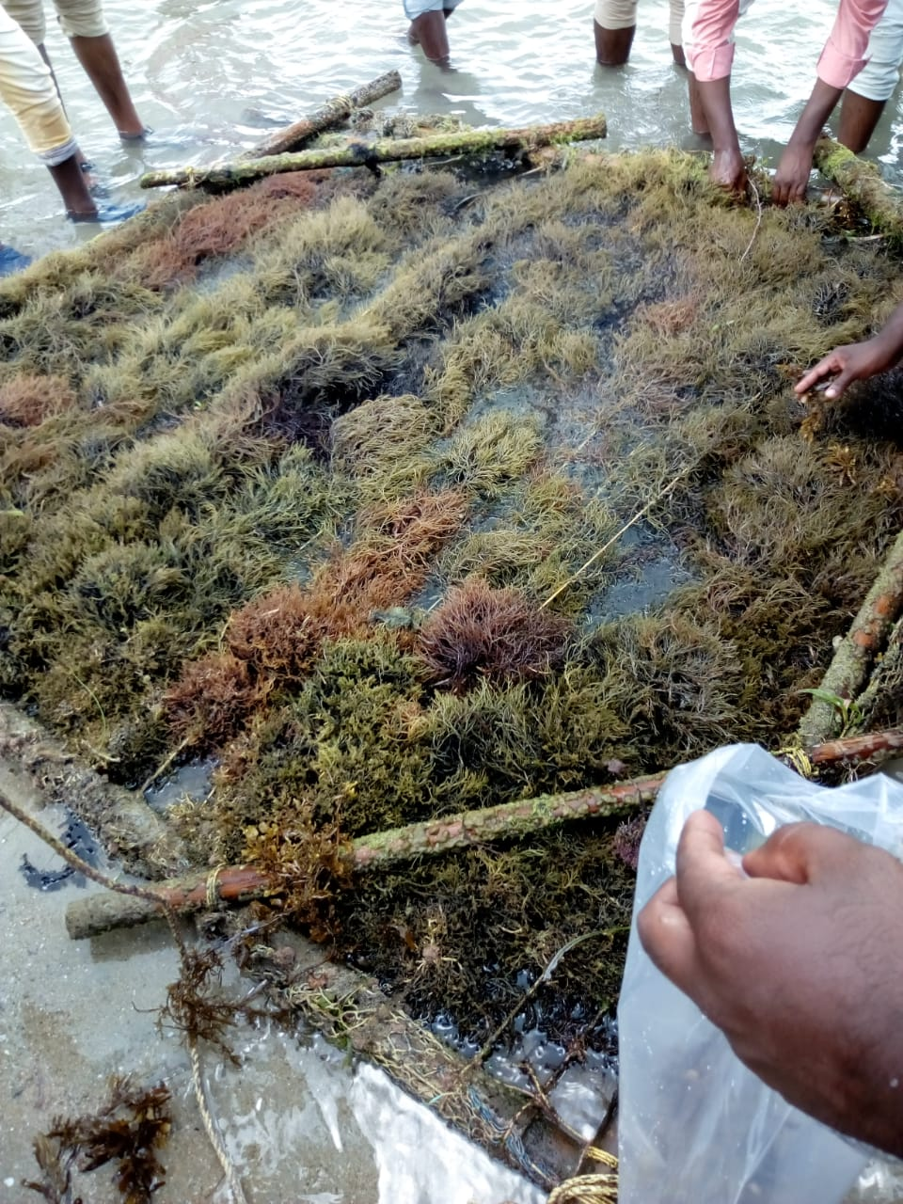
Algal collection @Mandabam, Rameshwaram With the help of CFTRI Scientists.

Slide 14
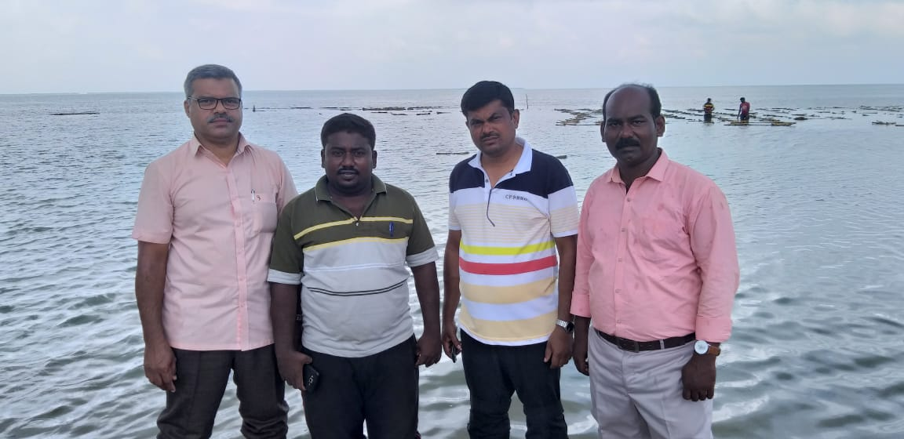
Rameshwaram algal cultivation area near Mandabam with faculties.

Slide 15
LAB VISITS
BY
BOTANY DEPARTMENT STUDENTS

Slide 16
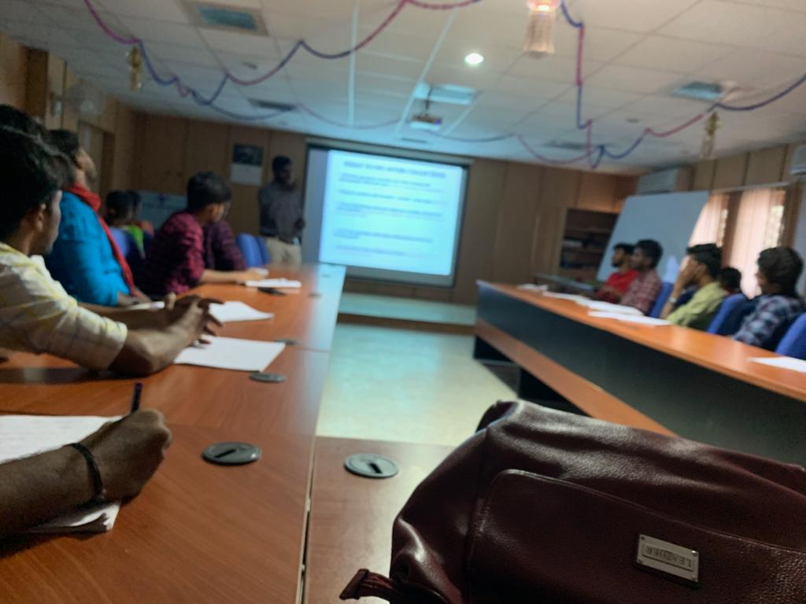
Botanical survey of India (BSI) Taxonomy-plant identification Training

Slide 17
BSI

Slide 18
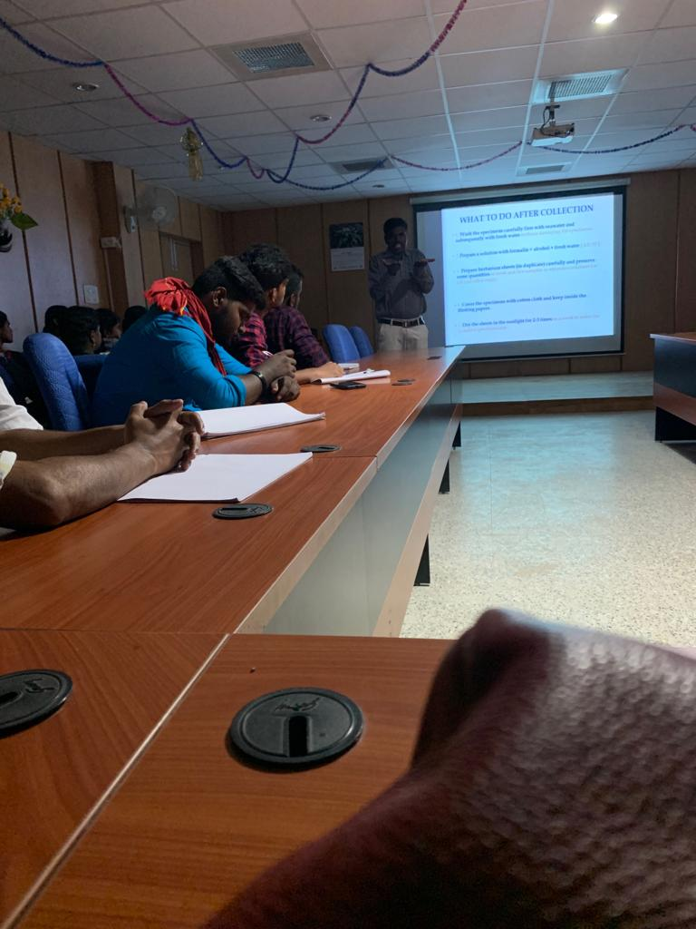
Plant key preparation class

